Slide 1


Causes and Consequences of Australia’s Aging Population
Group 10

Slide 2


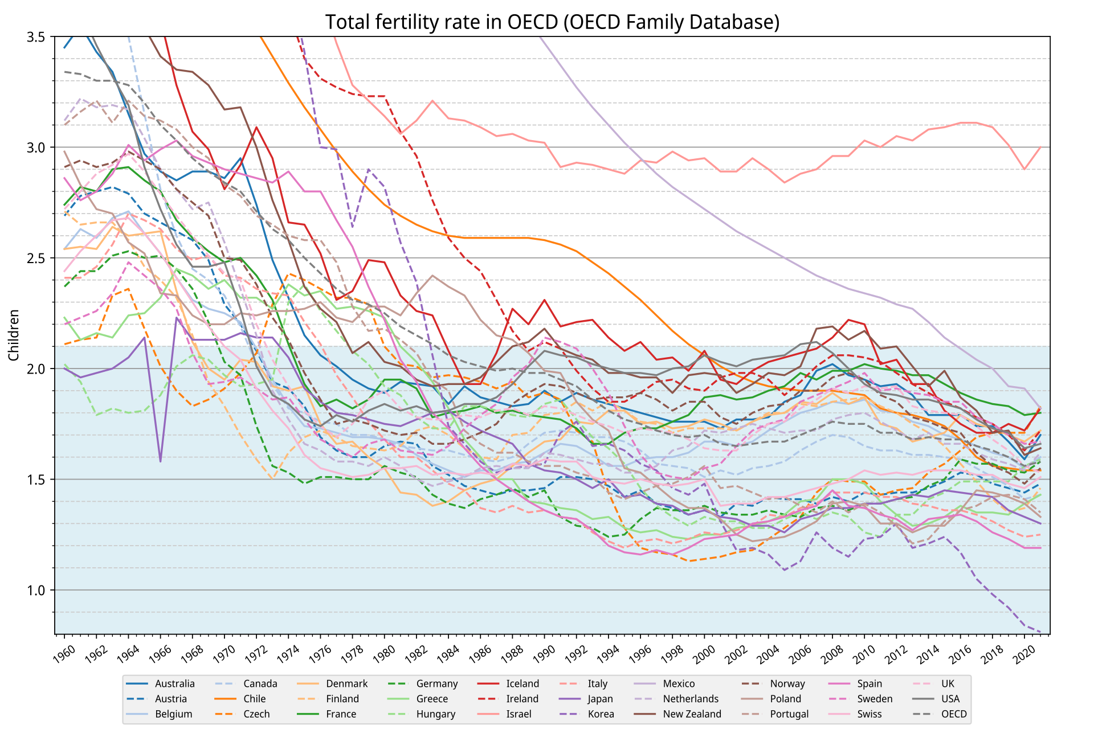
Topic Relevance
Countries with a birth rate below 2.1 trend towards a population decline
97% of OECD countries have a birth rate below 2.1

Slide 3
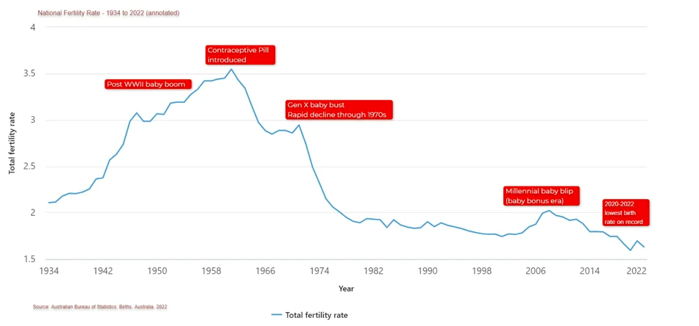
The Problem with Declining Birth Rates
Aging Population
Shrinking Workforce
Regional Imbalances
Social Inequality
Stress on Healthcare System
Australia Birth Rate from 1934 - 2022

Slide 4

Key Stakeholders
Government Agencies
Policy Makers
Economist
Social Planners
People in Society

Slide 5
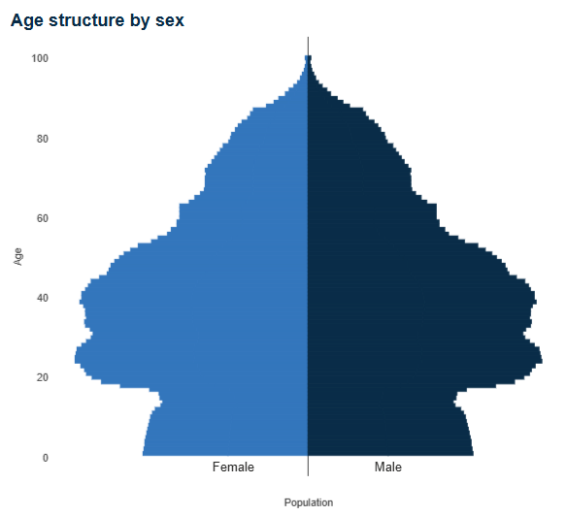
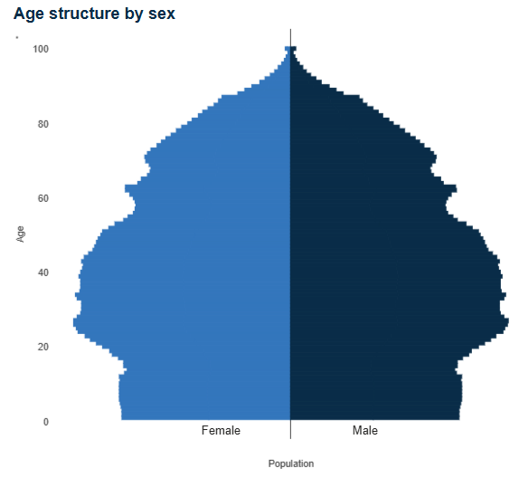
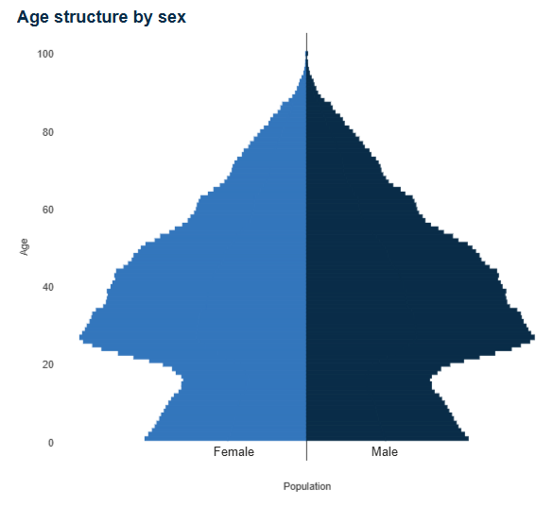
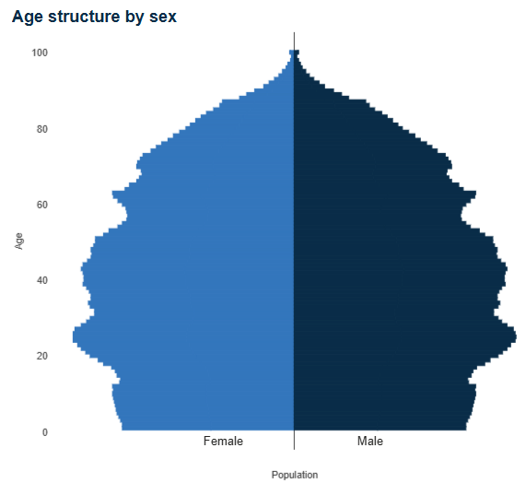
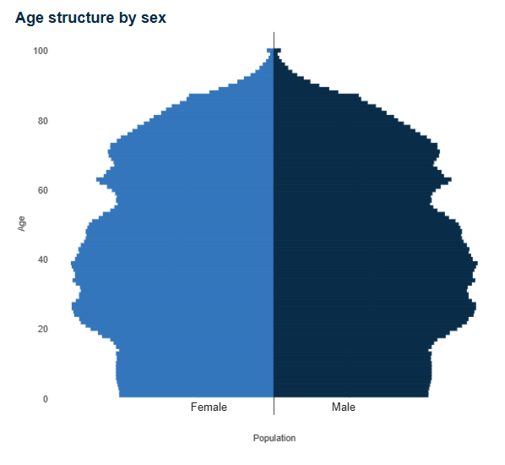
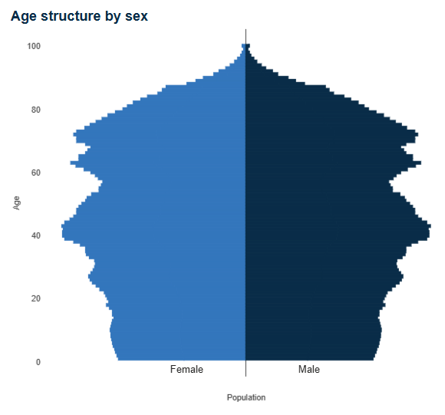
Areas to Analyze
Australia vs the World
Australian States
Major Cities
Urban vs Rural
ACT
NSW
NT
QLD
SA
TAS

Slide 6
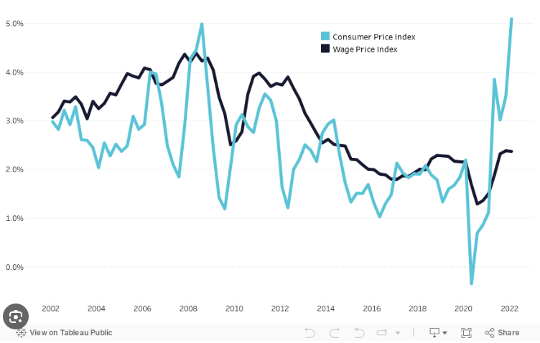
Areas to Compare
CPI and Wage Index
Real Estate
Unemployment Rate
ASX
Global Temperatures
Marriage Statistics
Education Enrollment
Life Expectancy
Covid-19

Slide 7
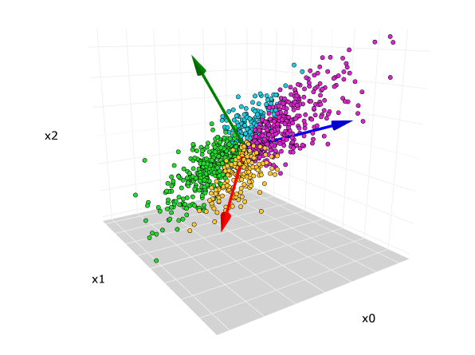
Possible Data Science Techniques
EDA
Correlation analysis
PCA
Clustering
Multi Linear Regression

Slide 8

Problems to Solve
Identify key factors to aging population
Analyze economic impacts of aging population
Predict Australia’s population trend in the next 50 years
Provide insights to stakeholders

Slide 9
Data Sources
ABS – Population: Births, Australia, 2022 | Australian Bureau of Statistics (abs.gov.au)
ABS – CPI: Consumer Price Index, Australia, June Quarter 2024 | Australian Bureau of Statistics (abs.gov.au)
ABS – WPI: Wage Price Index, Australia, June 2024 | Australian Bureau of Statistics (abs.gov.au)
Real Estate: AIHW Housing Data Dashboard | Housing data
Student enrollment: Student Data - Department of Education, Australian Government

